Slide 1

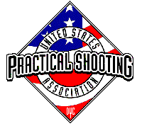
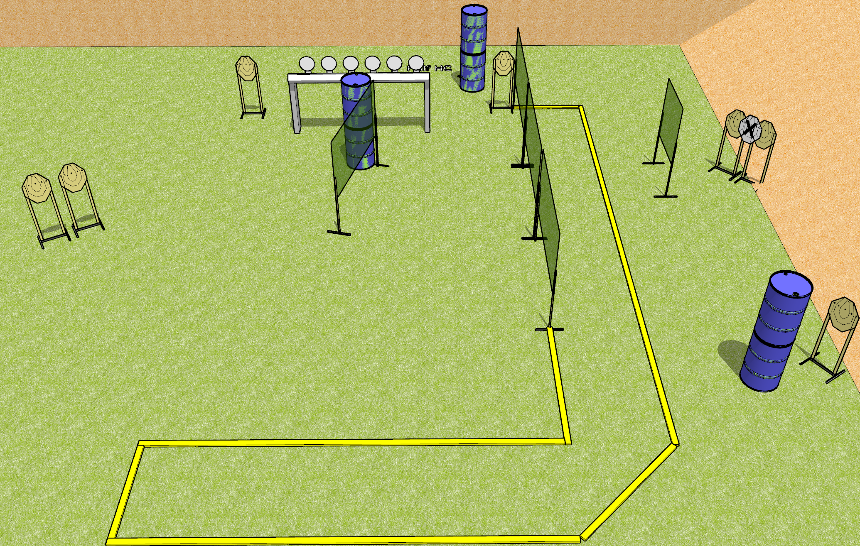
 | Dothan Gun Club – USPSA Match Half Rack Course Designer : Drew Coleman
Round Count 22 rounds 8 IPSC 6 Falling Plates
Equipment List 3 medium fault lines 8 wall feet 1 half HC

Slide 2
Half Rack
Written Stage Briefing
Half Rack is a 22 round, 110 point, Comstock course of fire. There are 8 IPSC targets and 6 falling plates. The best 2 hits on paper will score, and steel must fall to score. The start signal is audible.
Handgun start position is anywhere outside the shooting area, wrists below belt. Handgun is loaded and holstered.
PCC start position is anywhere outside the shooting area, stock on belt. Carbine is loaded with safety on.
On start signal engage targets as they become available from within the shooting area.

